Slide 1

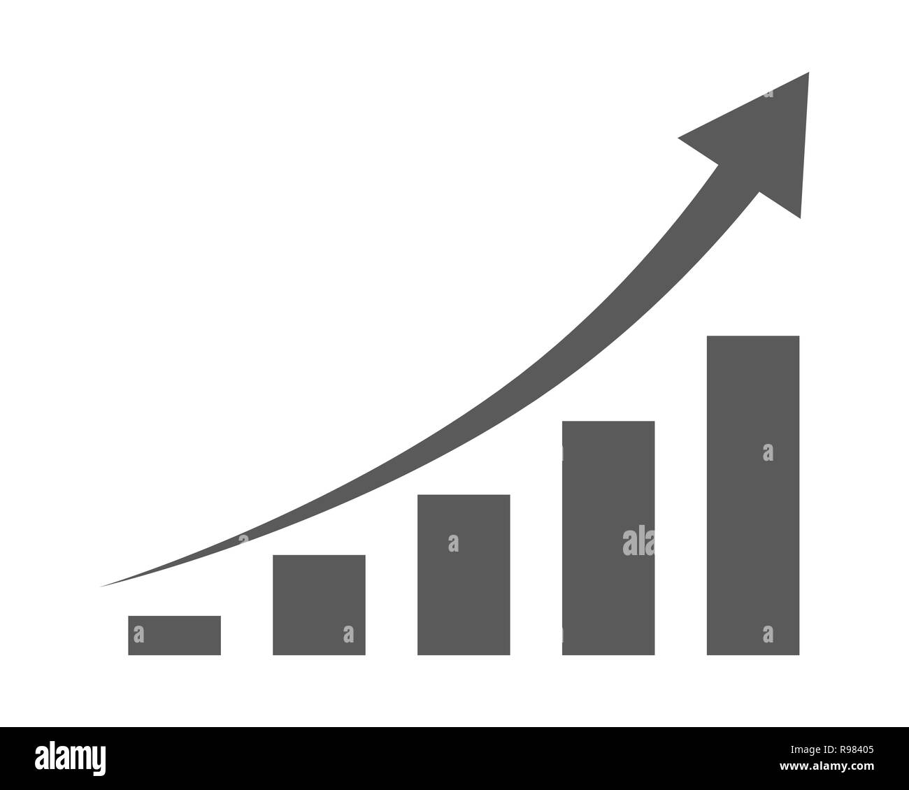
Garment Worker Productivity Prediction
PROJECT
PRESENTATION
Roshni Kothapalli (22BCE3709)
Maahie Gupta (22BLC1165)
Riddhi Bandyopadhyay (22BCE1068)
Yuganshu Kumar (22BLC1370)

Slide 2


001
TABLE OF CONTENTS
Introduction
Project Overview
Objectives
Problem Statement
Proposed Solution
Implementation
Output
Advantages and Disadvantages
Future Scope
Conclusion
002
004
005
006
008
009
010
011
012
013

Slide 3

INTRODUCTION

Slide 4
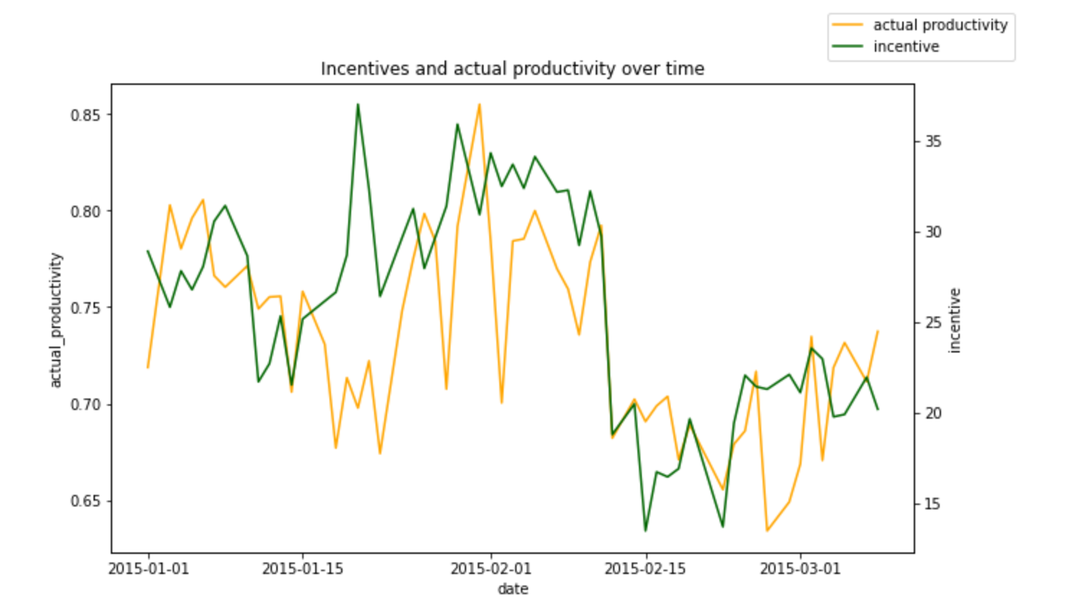
003
The garment industry is a prime example of modern globalization, relying heavily on manual labor. Meeting global demand hinges on factory worker performance. Industry leaders want to monitor, analyze, and forecast team productivity. The created sample dataset can be used to predict productivity levels, making it a valuable tool for regression analysis.

Slide 5

004
PROJECT OVERVIEW
The garment industry's success hinges on worker productivity. A machine learning-based prediction model can significantly impact manufacturing, HR, and supply chain management. By identifying productivity factors, companies can take corrective actions to boost efficiency, cut costs, and gain a competitive edge. This model can be a game-changer for the industry.

Slide 6

005
OBJECTIVES
Our project aims to develop a machine learning model that predicts garment worker productivity based on various production attributes. Our dataset includes features like quarter, department, day, team number, and more.
We'll use this data to train and evaluate our model, which will learn to predict productivity from these inputs, enabling more informed decisions in the garment industry.

Slide 7

PROBLEM STATEMENT

Slide 8



007
Problem Statement
A garment industry manager is struggling to boost profitability due to the complexity of predicting worker productivity, which depends on multiple factors. To overcome this challenge, they recognize the need for a machine learning model that can accurately forecast productivity by considering these various attributes.

Slide 9


008
PROPOSED SOLUTION
By leveraging machine learning, the garment worker productivity prediction model can enhance efficiency and accuracy, leading to fairer and more efficient workforce management. This can improve garment workers' lives, while also helping manufacturers optimize their strategies, minimize idle time, and increase productivity. Ultimately, this initiative aims to drive better decision-making, reduce risks, and boost operational efficiency, resulting in higher worker satisfaction, profitability, and overall success.

Slide 10
009
IMPLEMENTATION

Slide 11
010
OUTPUT

Slide 12
011
Advantages and Disadvantages
The garment worker productivity prediction model has the potential to bring about a transformative impact on the lives of garment workers by fostering a fair and efficient work environment. By promoting equitable and effective workforce management practices, the model can help ensure that workers are treated with dignity and respect, and are provided with a safe and healthy work environment. This, in turn, can lead to increased job satisfaction, better morale, and improved overall well-being of garment workers.
Moreover, the model can have far-reaching implications for the garment manufacturing industry as a whole. By optimizing workforce management strategies, manufacturers can reduce idle time, increase productivity, and ultimately, boost their bottom line. This can result in higher profits, lower production costs, and improved quality of goods produced, making the industry more competitive and sustainable.
However, despite its potential, the model is not without its limitations. A significant constraint is that it has been trained and tested on a very limited dataset, due to the lack of availability of multiple datasets. This limited dataset may not be representative of the diverse range of garment manufacturing settings, worker demographics, and production processes that exist in the industry. As a result, the model's accuracy and generalizability may be compromised, and it may not be able to capture the complexity and variability of real-world garment manufacturing scenarios. Therefore, it is essential to collect and incorporate more diverse and comprehensive datasets to further develop and refine the model, and to ensure its effectiveness in real-world applications.

Slide 13
012
Future Scope
The model can be enhanced to identify factors affecting worker productivity, such as working conditions, incentives, and training. This analysis can help manufacturers:
By providing actionable insights, the model can help manufacturers develop a more effective workforce management strategy, reducing idle time and increasing productivity.
Optimize the work environment for comfort and safety,
Design effective incentive schemes to motivate workers,
Identify areas for training and upskilling to improve performance, etc.

Slide 14
CONCLUSION
The successful implementation of the model can have a positive impact on garment workers, resulting in increased job satisfaction, fairer compensation, and safer working conditions. Additionally, the industry can benefit from increased profitability, reduced production costs, and enhanced product quality, ultimately leading to a more sustainable and successful business operation.

